Slide 1
Hadoop Distributed File System
Session Three

Slide 2
HDFS Overview
  Hadoop Distributed File System is a distributed file system designed
  to run on commodity hardware. It has many similarities with
  existing distributed file systems. However, It has differences from
  other distributed file systems are significant. HDFS is highly
  fault-tolerant and is designed to be deployed on low-cost
  commodity hardware. HDFS provides high throughput access to
  application data and is suitable for applications that have large data
  sets. HDFS relaxes a few POSIX requirements to enable streaming
  access to file system data.

Slide 3
Design Goals
The major design principles or assumptions in the Hadoop Distributed
File System design are:
Hardware Failure
Streaming Data Access
Large files
Simple Coherency Model
Data Localization
Fault – tolerant
Deploy on Commodity Hardware
Reliable and High throughput
Heterogeneous Hardware and Software platforms

Slide 4
HDFS Limitations
Hadoop Distributed File System has some limitations. The following are some of
the limitations:
Record level inserts, updates, deletes
High Latency
Too many small files
Multiple Writers

Slide 5
Components of HDFS
HDFS is one of the core parts of Hadoop
It is designed based on Master-Slave Architecture
It has components like NameNode, DataNodes, Secondary NameNode,
Checkpoint Node, Backup Node.
NameNode – Master of the HDFS
DataNodes – Slave of HDFS
Secondary NameNode – Snapshot of NameNode (with small delay)
Checkpoint Node – Replacement for Secondary NameNode
Backup Node – Mirror Image of NameNode
It has several configuration properties to customize the HDFS.
All the parameters are specified in hdfs-site.xml

Slide 6
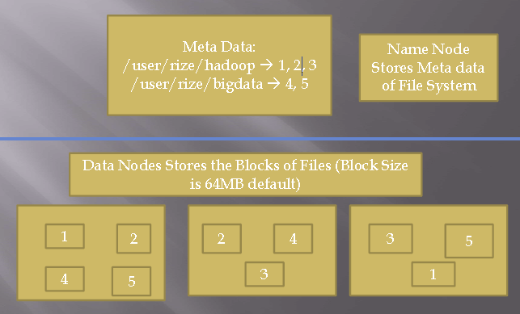
HDFS Architecture

Slide 7
HDFS Concepts
File System Name Space
Persistence of File System Meta data
Protocols
Rack awareness
Disk failure, Re-replication, Data Integrity, Cluster balancing, Heartbeats
Data Organization
  Blocks
  Staging
  Replication pipeline
Data Replication
  Replica Placement
  Safemode
  Replica Selection
Accessibility
  FS Shell
  DFS Admin
  Web Browser Interface
  Java HDFS API

Slide 8
HDFS Commands
HDFS has a list of commands
These commands are in two categories:
User commands
  archive
  distcp
  fs
  fsck
Admin commands
  balancer
  daemonlog
  datanode
  dfsadmin
  namenode
  secondarynamenode

Slide 9
Others
File Deletes and Un deletes.
Replication Factor
Check Sums
Compression
Avoid small files
Choosing Block Size
Disk Usage
File Permissions
Security and Encryption
Hardware selection
  NameNode
  DataNodes

